Slide 1
Lab. 07
Logic Design Lab.
Fall 2019
Prof. Sungjoo Yoo
(yeonbin@snu.ac.kr)
TA. Hyunsu Kim
(gustnxodjs@gmail.com)
TA. Hyunyoung Jung
(gusdud1500@gmail.com)

Slide 2
Contents
Registers
Basic Register
4bit Shift Register
Shift Register Application
8bit Universal Shift Register
4bit Binary Counter
SNU LD Board
Lab

Slide 3
Registers

Slide 4
Single-Cycle Datapath
PCSrc
0MUX1
Add
4
Add
ALU
result
RegWrite
Shift left 2
Instruction [25-21]
Read register 1
Read data 1
MemWrite
PC
Read address
Instruction [20-16]
Read register 2
ALUSrc
MemtoReg
Instruction
Zero
[31-0]
0MUX1
Write register
Read data 2
0MUX1
ALU
ALU
result
Address
Read data
1MUX0
Instruction
Instruction [15-11]
Write data
memory
Registers
Write data
Data memory
RegDst
16
32
Instruction [15-0]
Sign extend
ALU control
MemRead
Instruction [5-0]
ALUOp

Slide 5
Single-Cycle Datapath
PCSrc
0MUX1
Add
4
Add
ALU
result
RegWrite
Shift left 2
Instruction [25-21]
Read register 1
Read data 1
MemWrite
PC
Read address
Instruction [20-16]
Read register 2
ALUSrc
MemtoReg
Instruction
Zero
[31-0]
0MUX1
Write register
Read data 2
0MUX1
ALU
ALU
result
Address
Read data
1MUX0
Instruction
Instruction [15-11]
Write data
memory
Registers
Write data
Data memory
RegDst
16
32
Instruction [15-0]
Sign extend
ALU control
MemRead
Instruction [5-0]
ALUOp

Slide 6
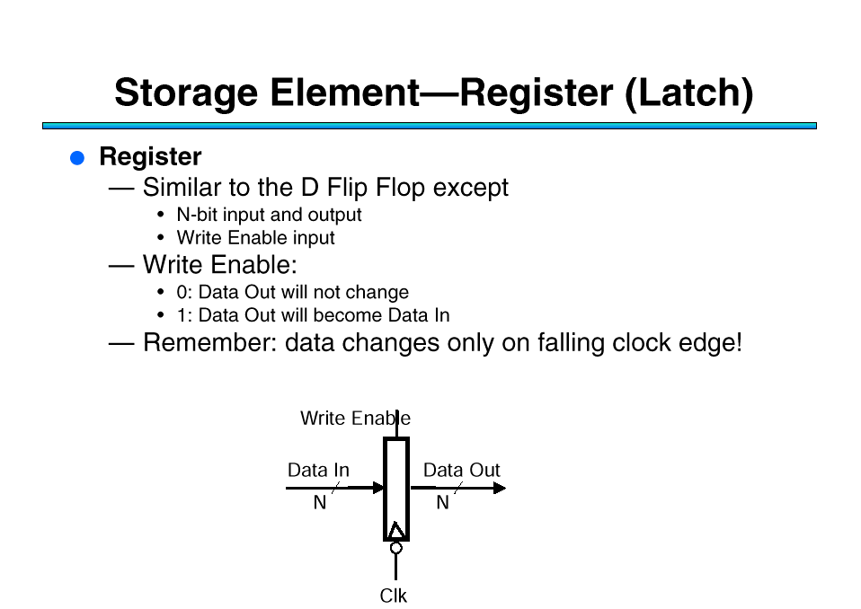
Basic Register
Register
Similar to the D Flip Flop except
N-bit input and output
Write Enable input
Write Enable(new update condition):
0: Data Out will not change
1: Data Out will be updated with Data in
OUT1
OUT2
OUT3
OUT4
"0"
R
S
R
S
R
S
R
S
D
Q
D
Q
D
Q
D
Q
CLK
IN1
IN2
IN3
IN4

Slide 7
4bit Shift Register
Holds samples of input
store last 4 input values in sequence
4-bit shift register:
OUT1
OUT2
OUT3
OUT4
IN
D
Q
D
Q
D
Q
D
Q
CLK

Slide 8
4bit Shift Register
Holds samples of input
store last 4 input values in sequence
4-bit shift register:
Time: 0
OUT1
OUT2
OUT3
OUT4
X
X
X
X
0
IN
D
Q
D
Q
D
Q
D
Q
CLK

Slide 9
4bit Shift Register
Holds samples of input
store last 4 input values in sequence
4-bit shift register:
Time: 1
OUT1
OUT2
OUT3
OUT4
0
X
X
X
1
IN
D
Q
D
Q
D
Q
D
Q
CLK

Slide 10
4bit Shift Register
Holds samples of input
store last 4 input values in sequence
4-bit shift register:
Time: 2
OUT1
OUT2
OUT3
OUT4
1
0
X
X
1
IN
D
Q
D
Q
D
Q
D
Q
CLK

Slide 11
4bit Shift Register
Holds samples of input
store last 4 input values in sequence
4-bit shift register:
Time: 3
OUT1
OUT2
OUT3
OUT4
1
1
0
X
0
IN
D
Q
D
Q
D
Q
D
Q
CLK

Slide 12
4bit Shift Register
Holds samples of input
store last 4 input values in sequence
4-bit shift register:
Time: 4
OUT1
OUT2
OUT3
OUT4
0
1
1
0
1
IN
D
Q
D
Q
D
Q
D
Q
CLK
And so on..

Slide 13
Shift Register Application

Slide 14
8bit Universal Shift Register
Holds 4 values
serial or parallel inputs
serial or parallel outputs
permits shift left or right
shift in new values from left or right
output
clear sets the register contents and output to 0 s1 and s0 (sel) determine the shift function s1 s0 function 0 0 hold state 0 1 shift right 1 0 shift left 1 1 load new input
left_in
right_out
left_out
right_in
clear
(sel)
s0
clock
s1
input

Slide 15
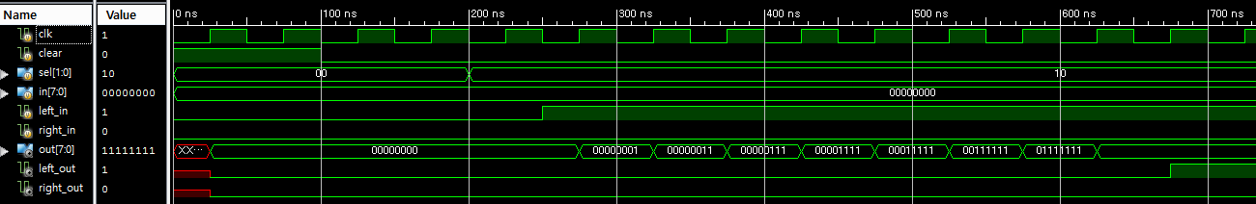
8bit Universal Shift Register
<Simulation>
For example, if sel == 2’b10(shift left), the result is…
sel <= 2’b10;
11111111
Initial output
Left_in <= 1’b1;
1 comes out

Slide 16
4bit Binary Counter
Logic between registers (not just multiplexer)
XOR decides when bit should be toggled
always for low-order bit, only when first bit is true for second bit, and so on
LSB MSB
OUT1
OUT2
OUT3
OUT4
D
Q
D
Q
D
Q
D
Q
CLK
"1"

Slide 17
4bit Binary Counter
Standard component with many applications
positive edge-triggered F/Fs w/ synchronous load and clear inputs
parallel load data from D, C, B, A
enable inputs: must be asserted to enable counting
ripple-carry out (RCO) is used for cascading counters
high when counter is in its highest state 1111
implemented using an AND gate
EN D C B A
LOAD
CLK
CLR
Preset
logic
RCO
QD QC QB QA
(2) RCO goes high
(3) High order 4-bits are incremented
(1) Low order 4-bits = 1111

Slide 18
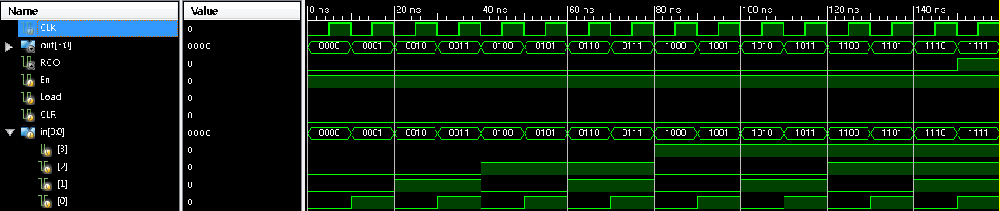
4bit Binary Counter
(2) RCO goes high
(3) High order 4-bits are incremented
(1) Low order 4-bits = 1111

Slide 19
Modeling a Sequential Circuit
For most sequential circuits (like universal shift register), it is hard to implement with gate-level modeling. So, you can use behavioral modeling.

Slide 20
SNU LD Board

Slide 21
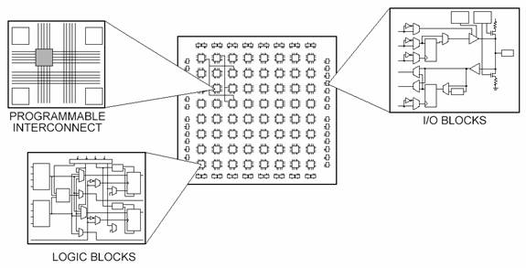
What is FPGA?
FPGAs(Field Programmable Gate Arrays) are semiconductor devices that can be programmed
2-D array of logic blocks and flip-flops with electrically programmable interconnections
Programmable Logic Device(PLD) with high density and capable of implementing different functions faster.
Functionalities of an FPGA can be (re)programmed by downloading a configuration into the device
Users configure
intersection between logic blocks
and function of each block

Slide 22
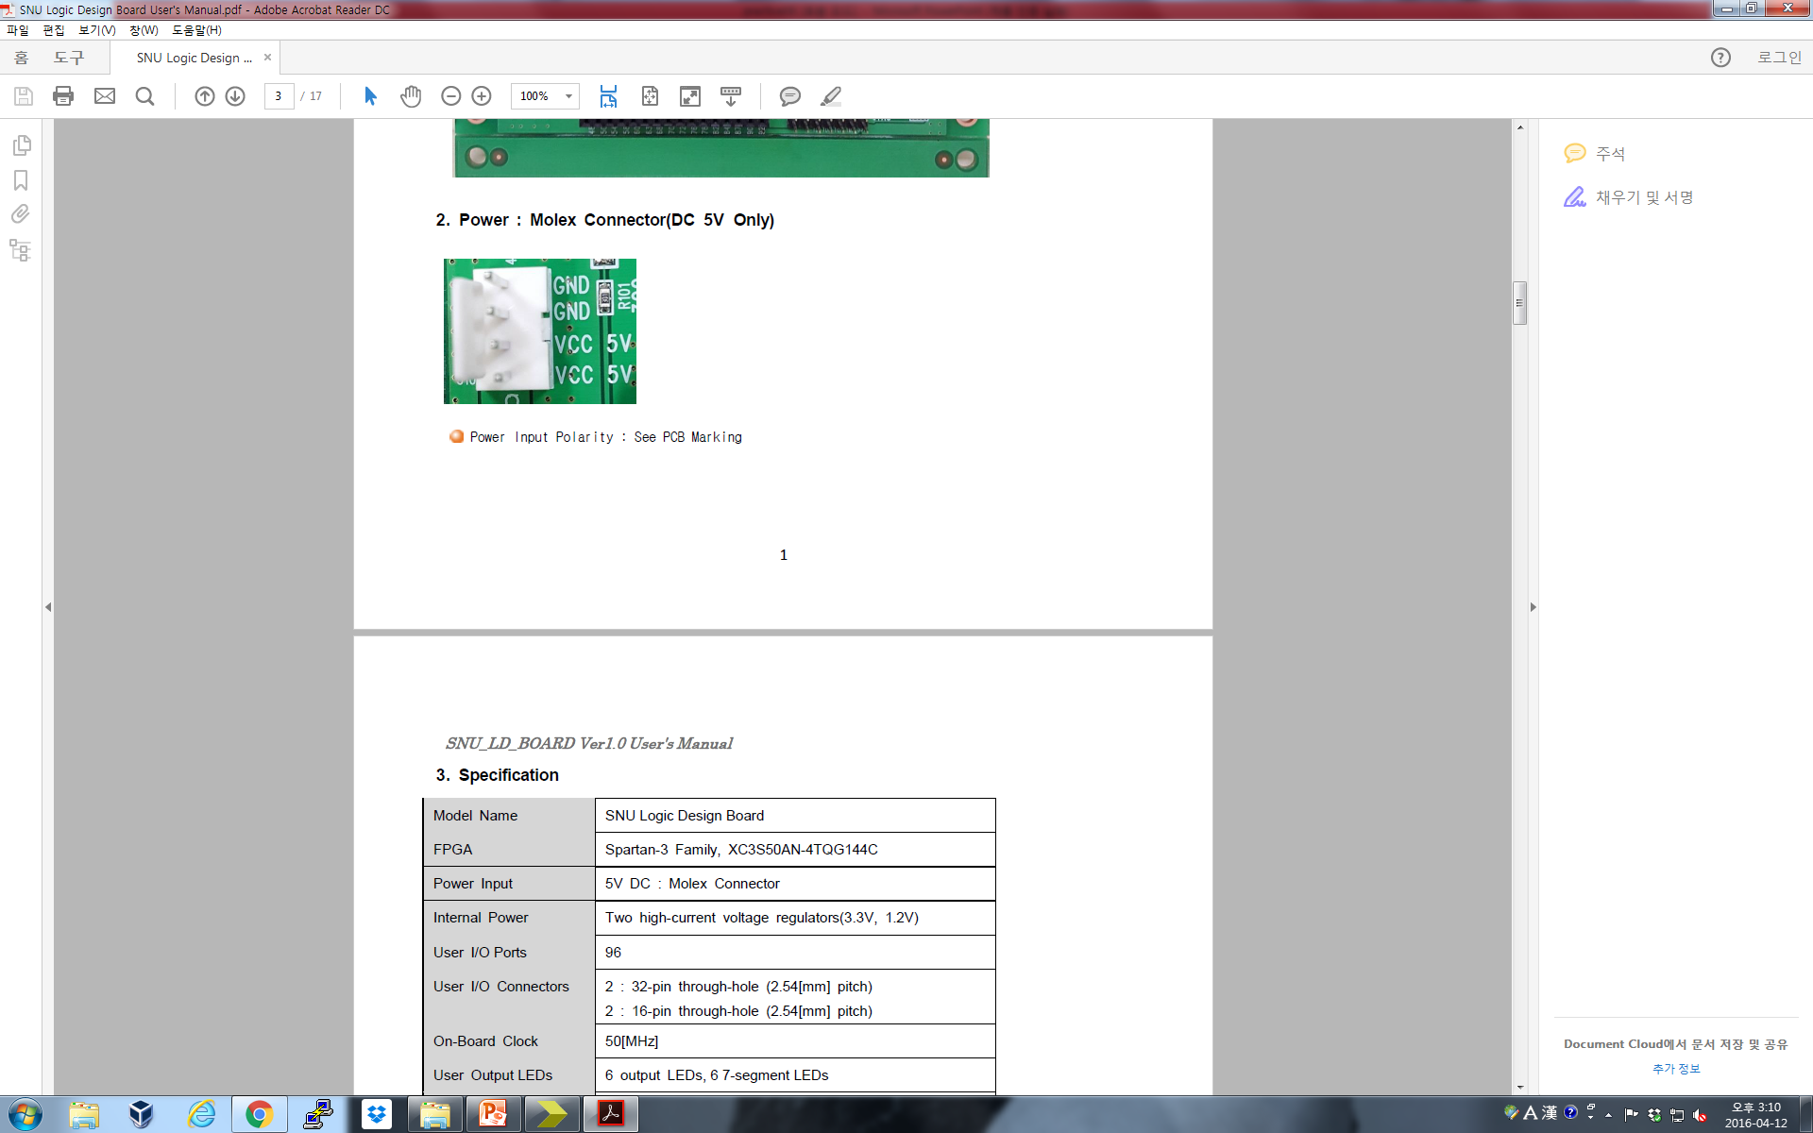
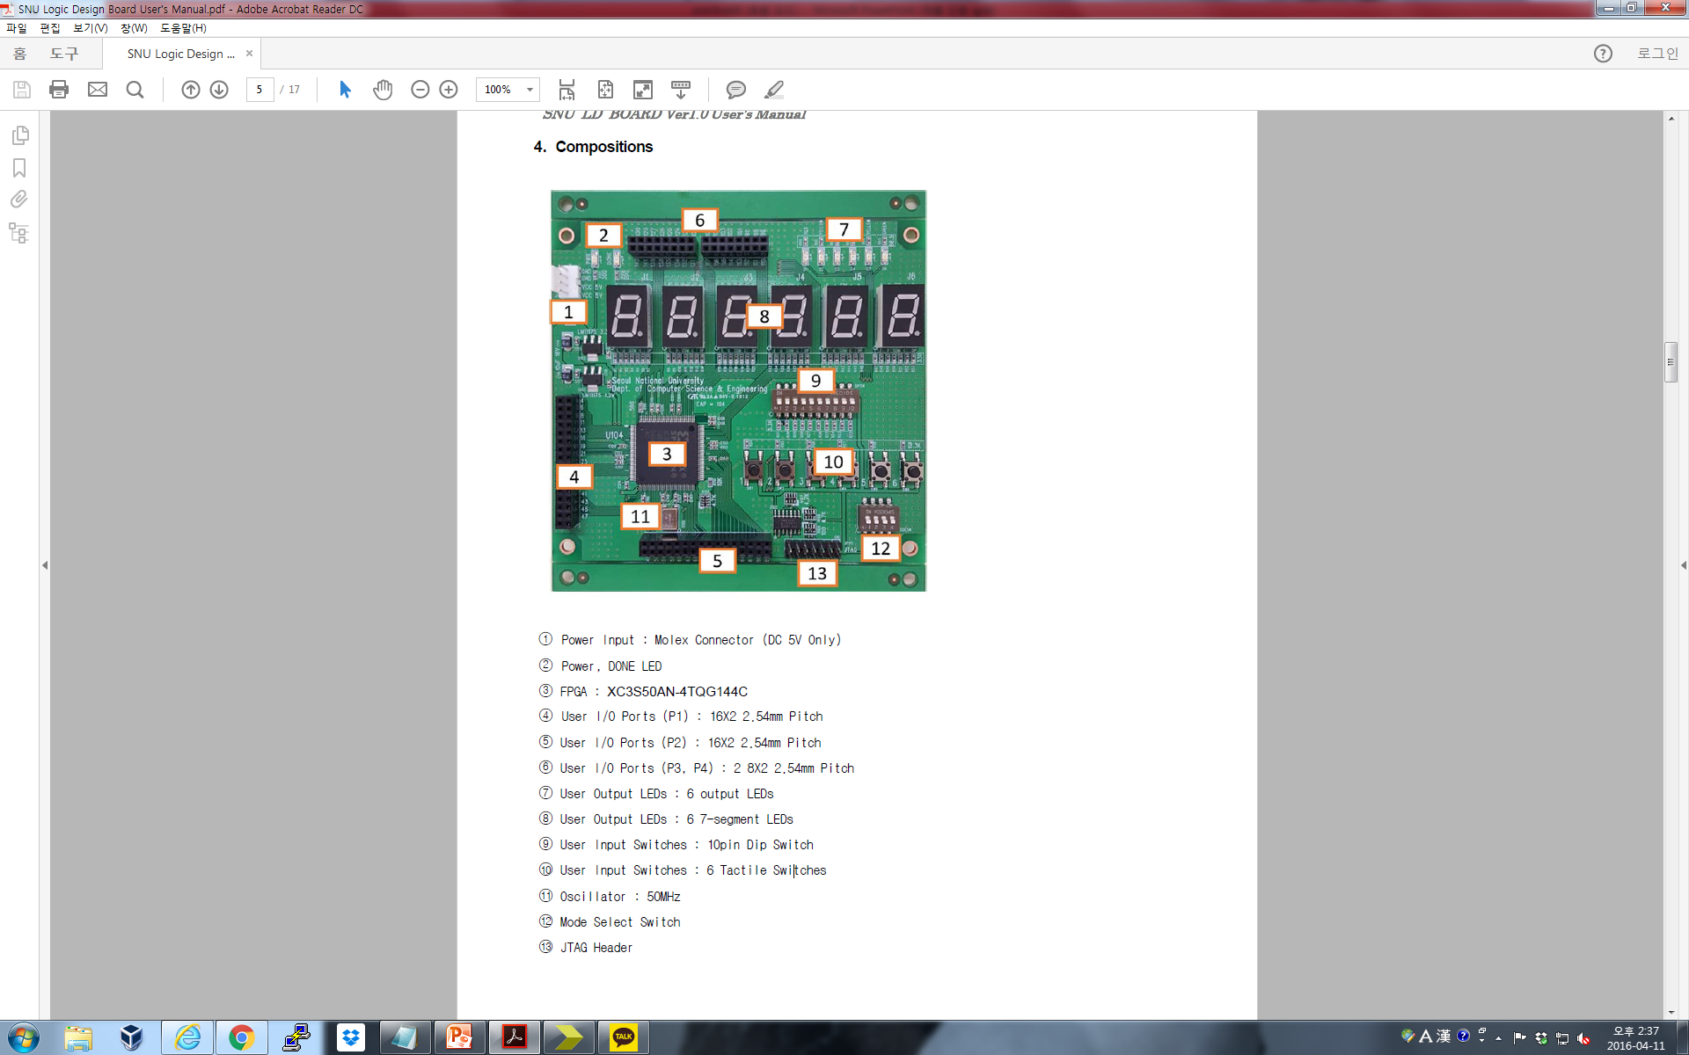
SNU Logic Design Board

Slide 23
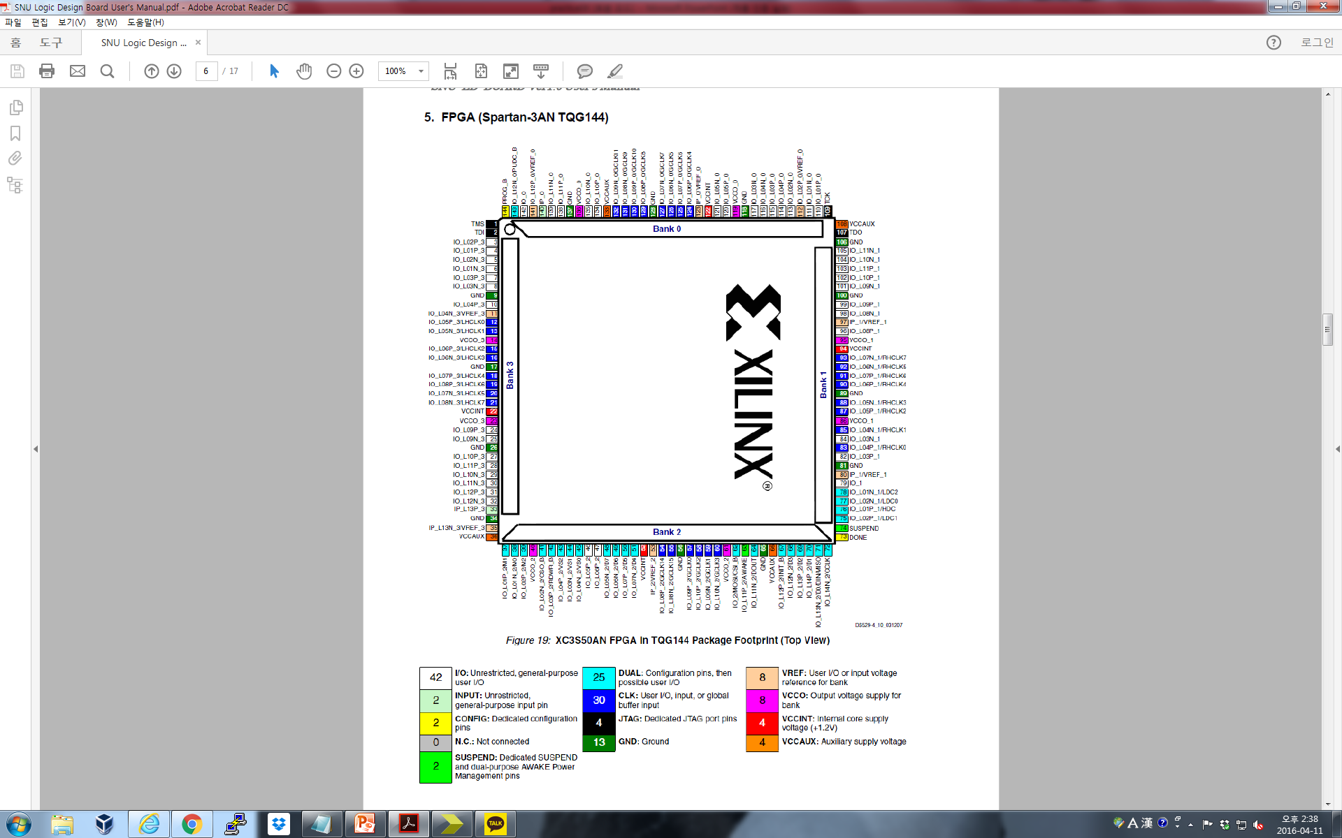
SNU Logic Design Board
FPGA(Spartan-3AN TQG144)

Slide 24
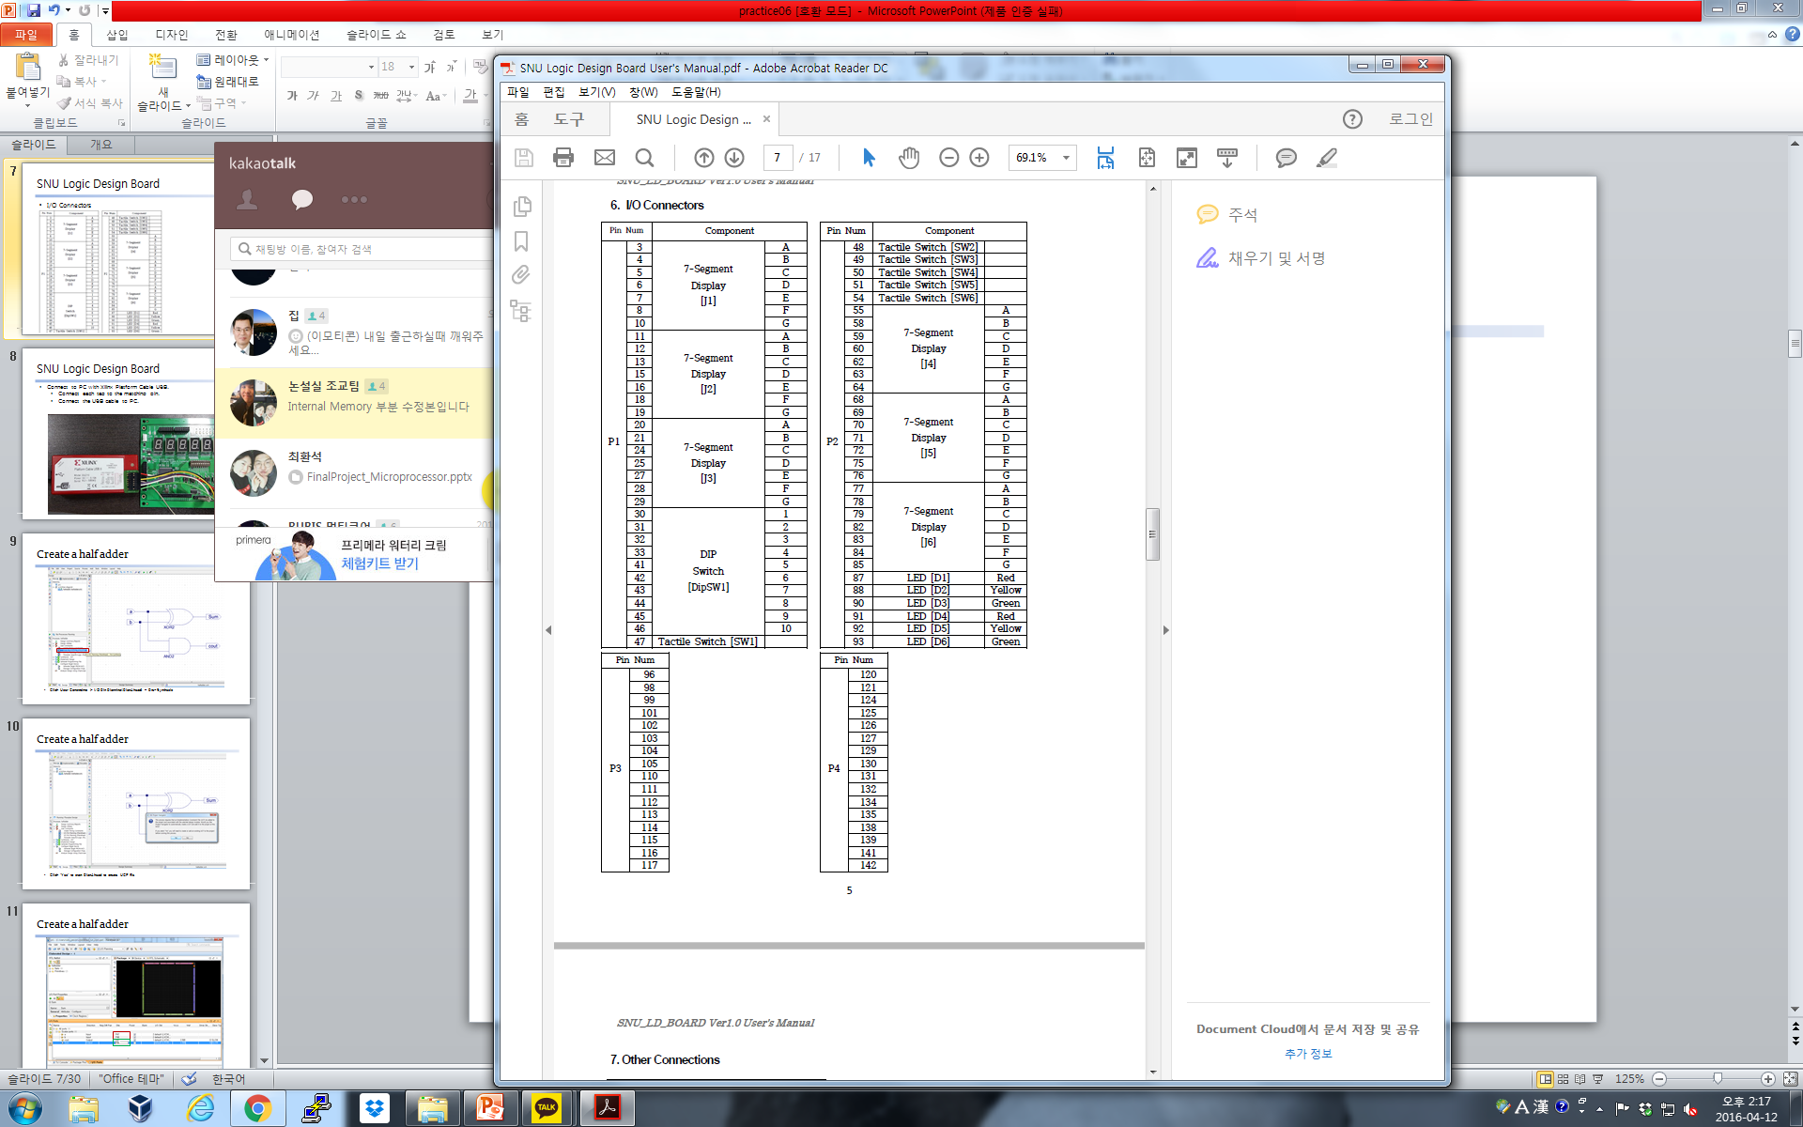
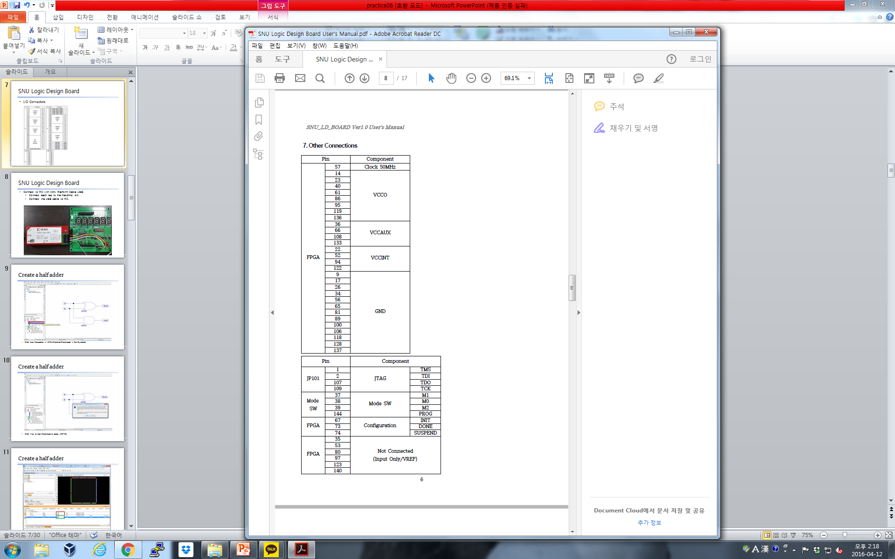
SNU Logic Design Board
I/O Connectors

Slide 25
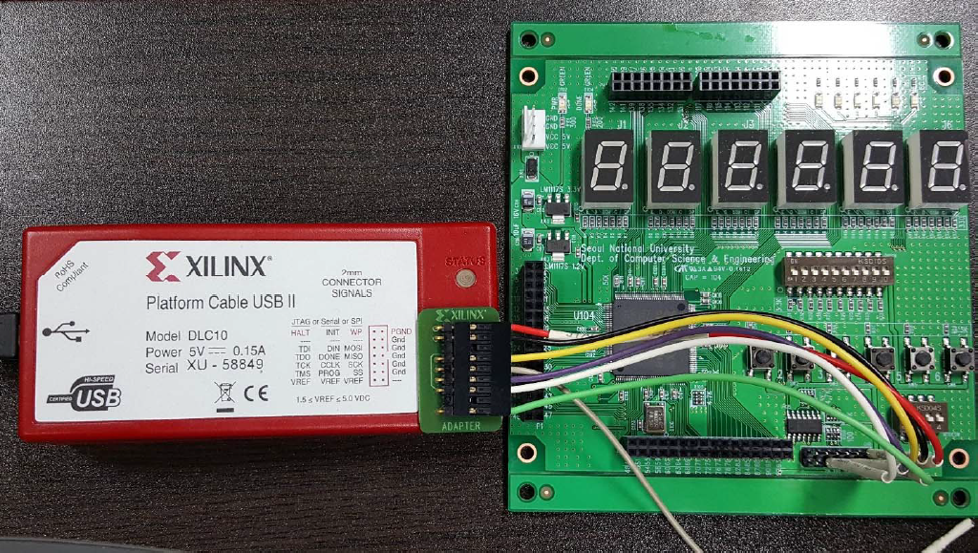
SNU Logic Design Board
Connect to PC with Xilinx Platform Cable USB
Connect each tag to the matching pin
Connect the USB cable to PC

Slide 26
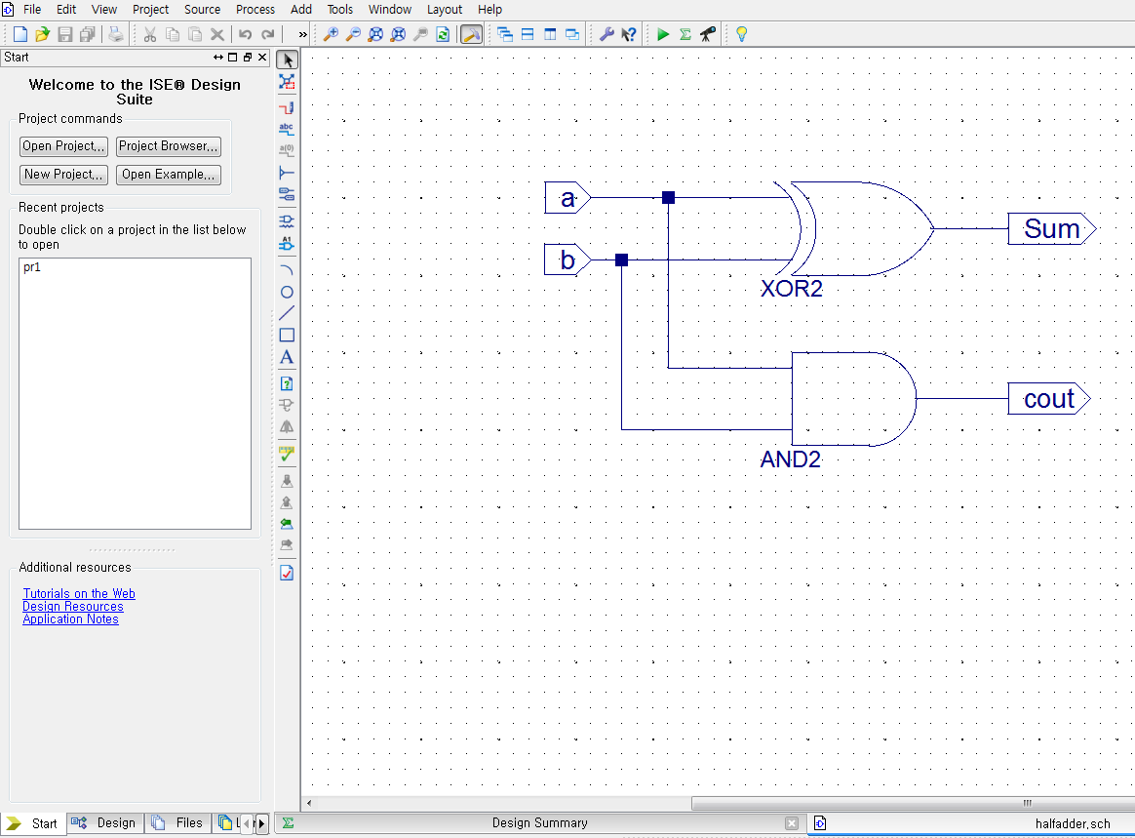
Half Adder on FPGA
Create a new project and make a half adder as a schematic source below

Slide 27
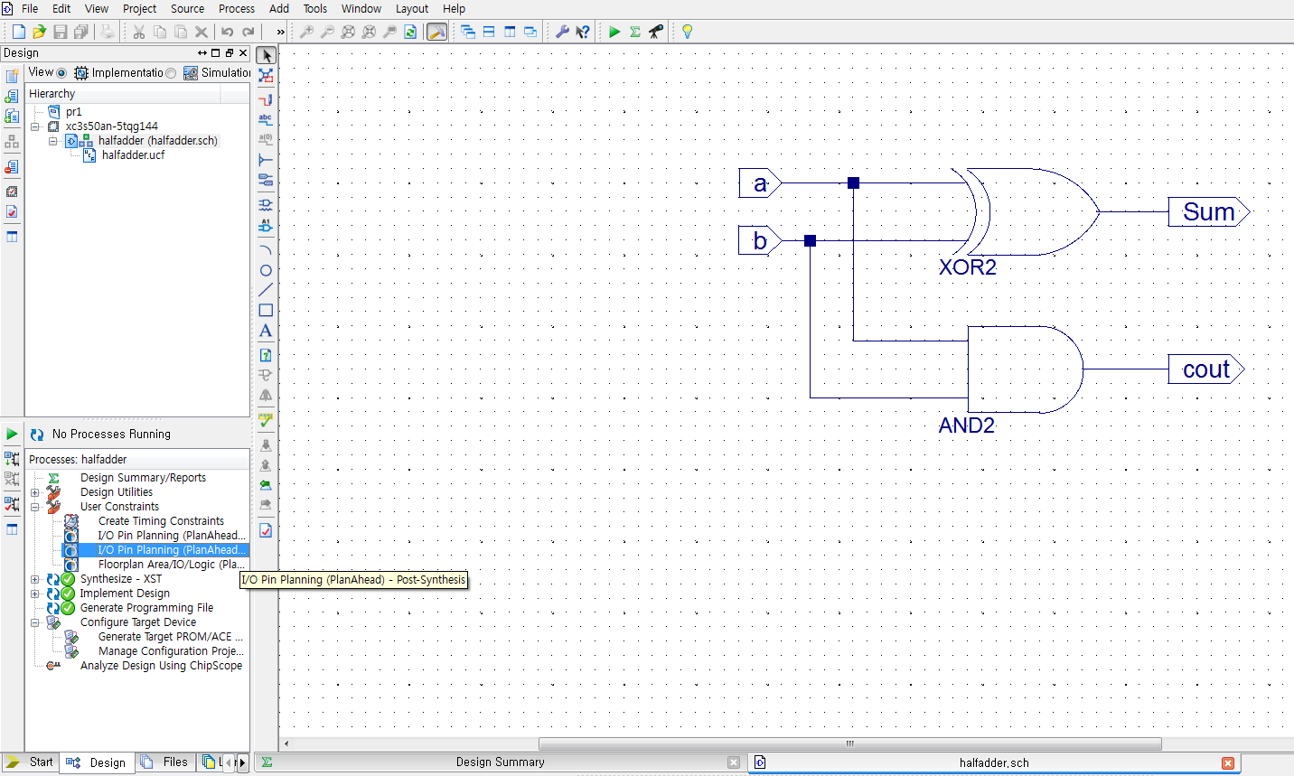
Half Adder on FPGA
On ‘Design’ tab, click User Constraints > I/O Pin Planning(PlanAhead) – Post-Synthesis

Slide 28
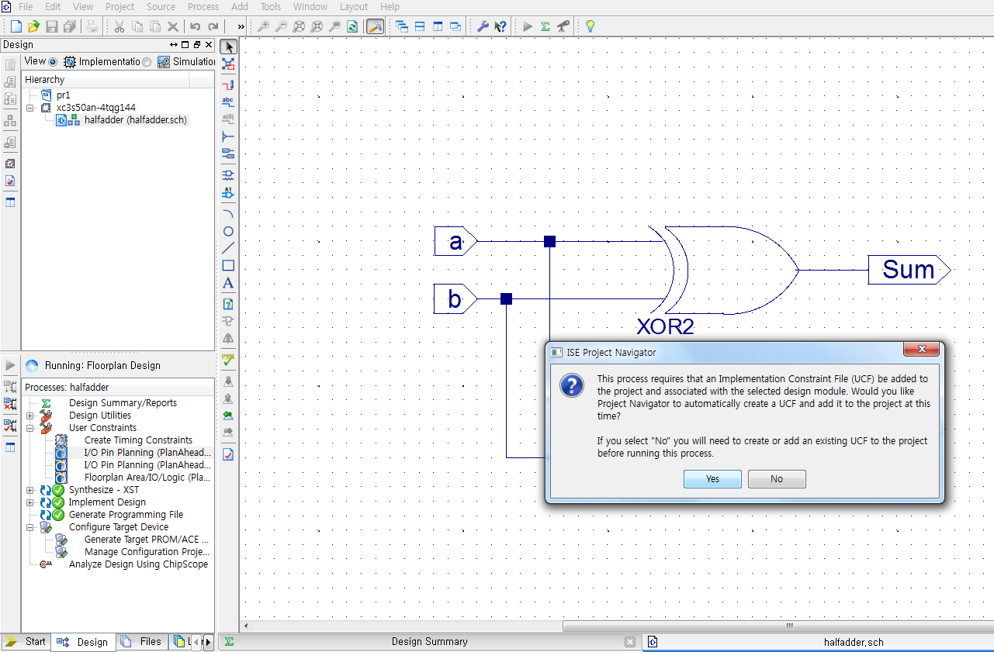
Half Adder on FPGA
Click ‘Yes’ to start PlanAhead to create UCF file

Slide 29
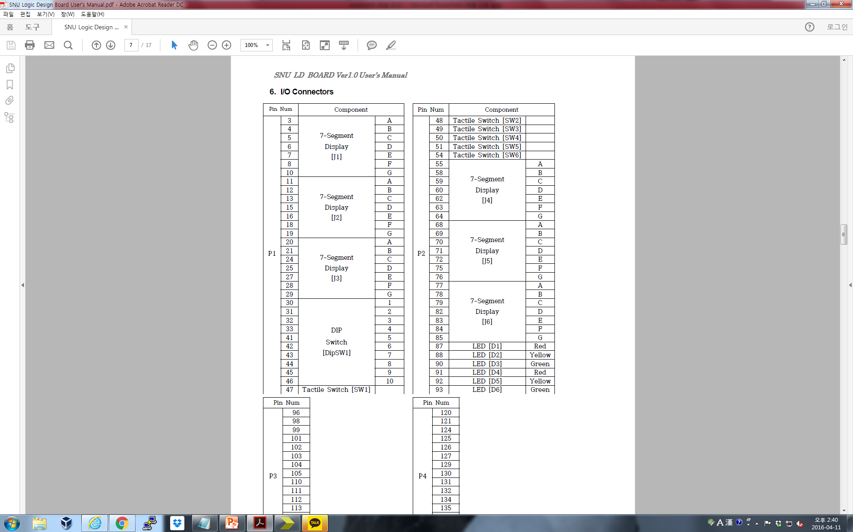
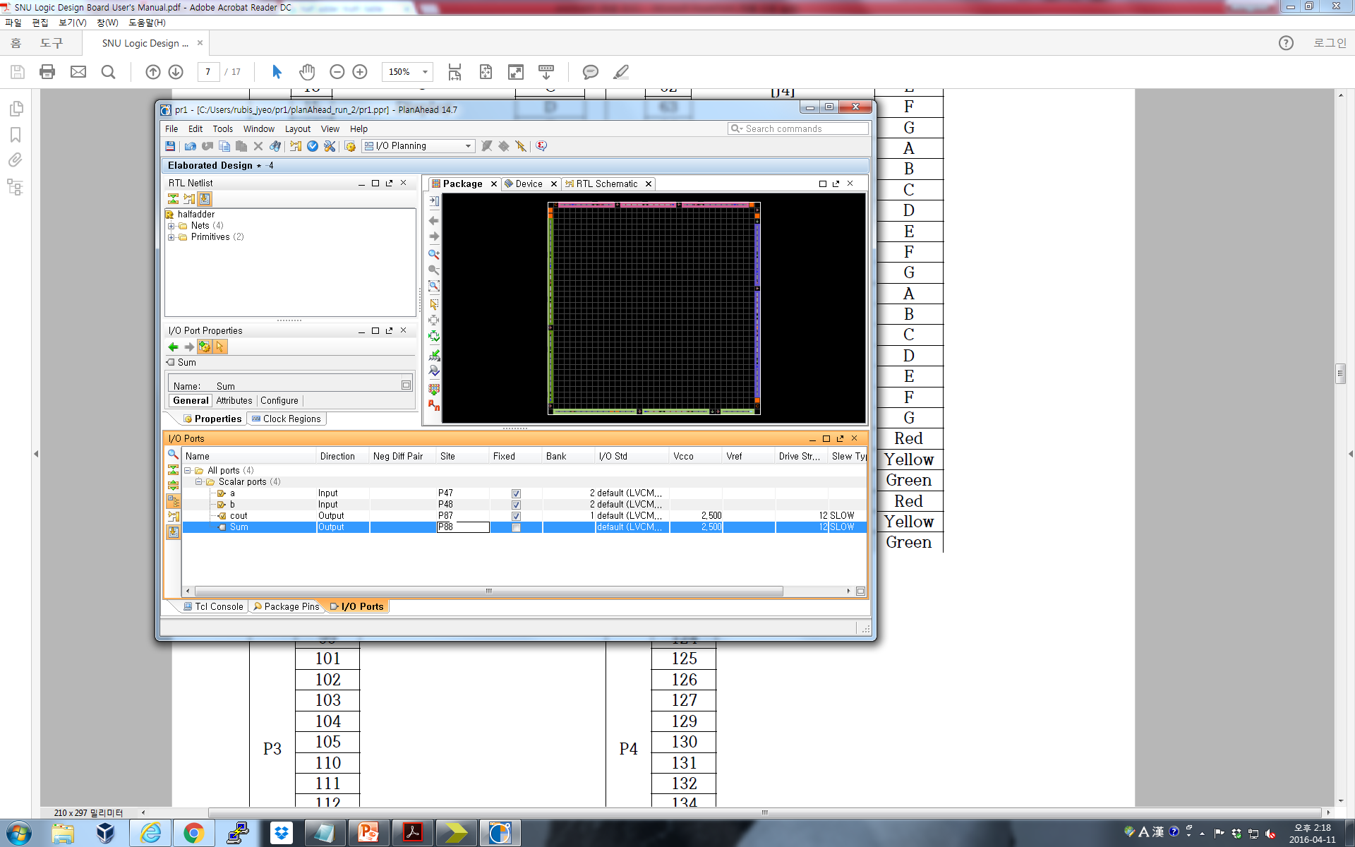
Half Adder on FPGA
Choose I/O pins that you’ll use for your half adder

Slide 30
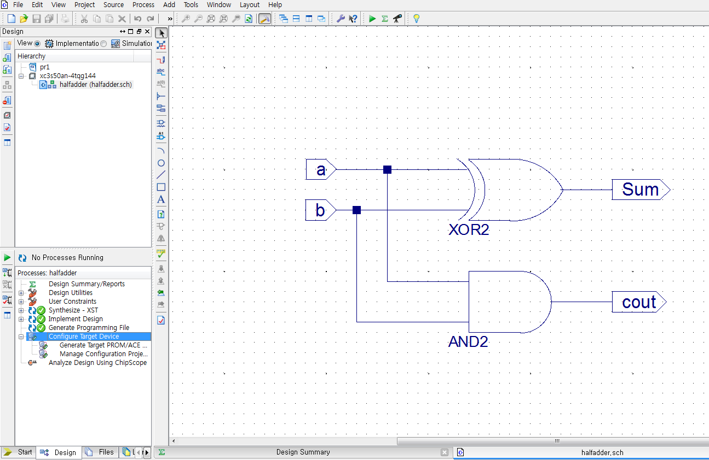
Half Adder on FPGA
Go to the ‘Design’ tab and double click ‘Configure Target Device’

Slide 31
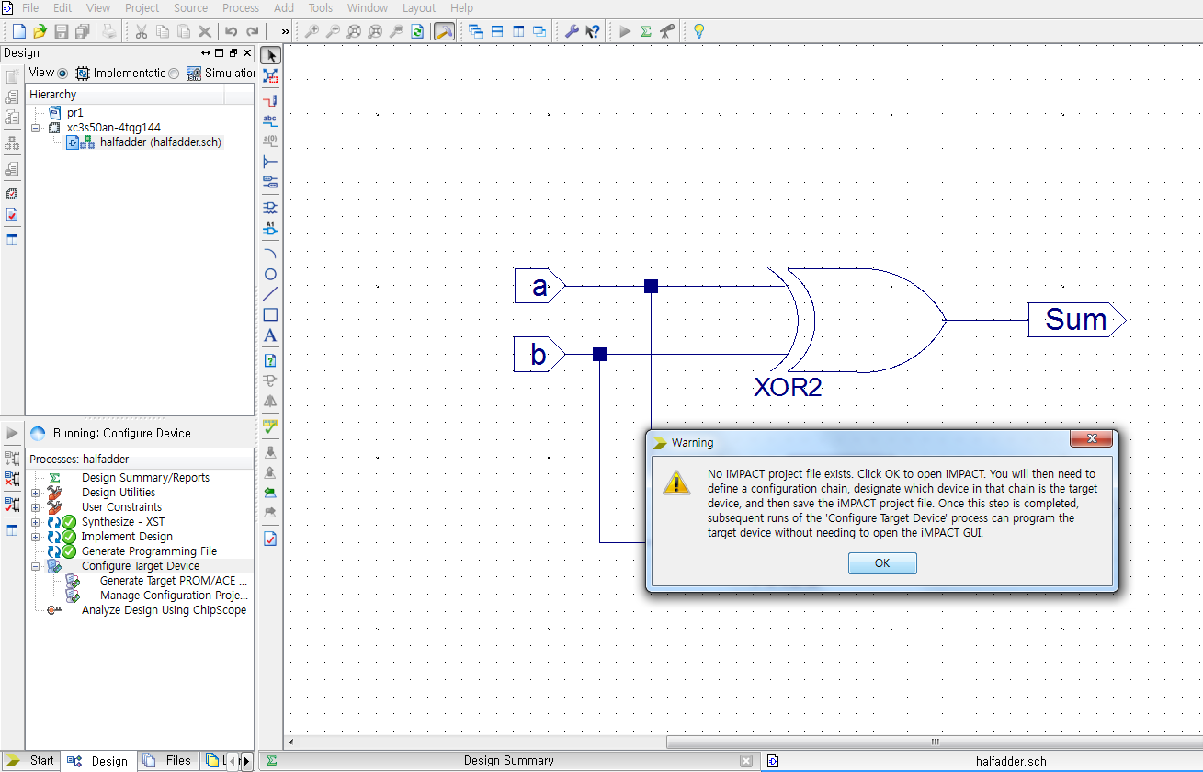
Half Adder on FPGA
Click OK to create an iMPACT file

Slide 32
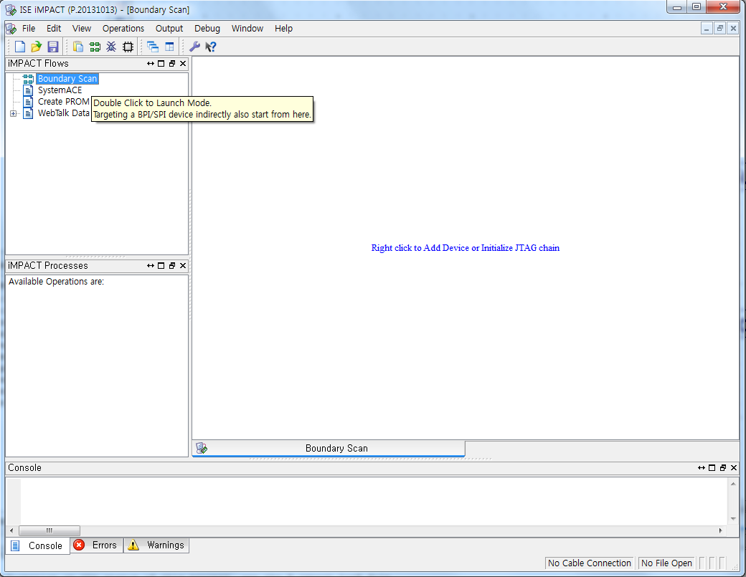
Half Adder on FPGA
Double click “Boundary Scan”

Slide 33
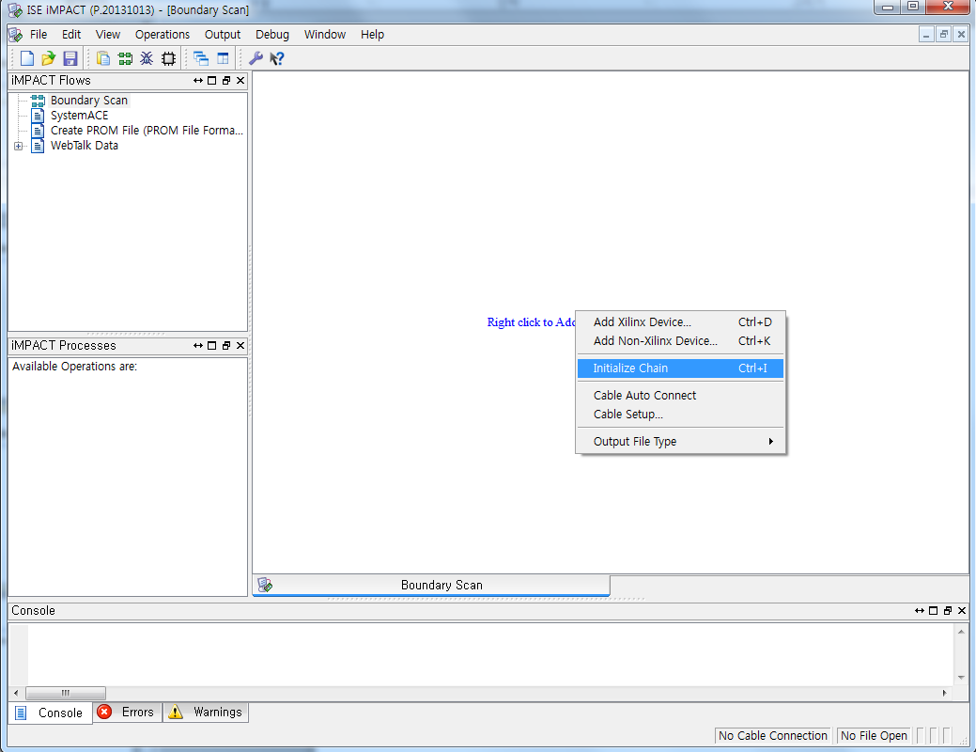
Half Adder on FPGA
Right click the blue words and click ‘Initialize Chain’

Slide 34
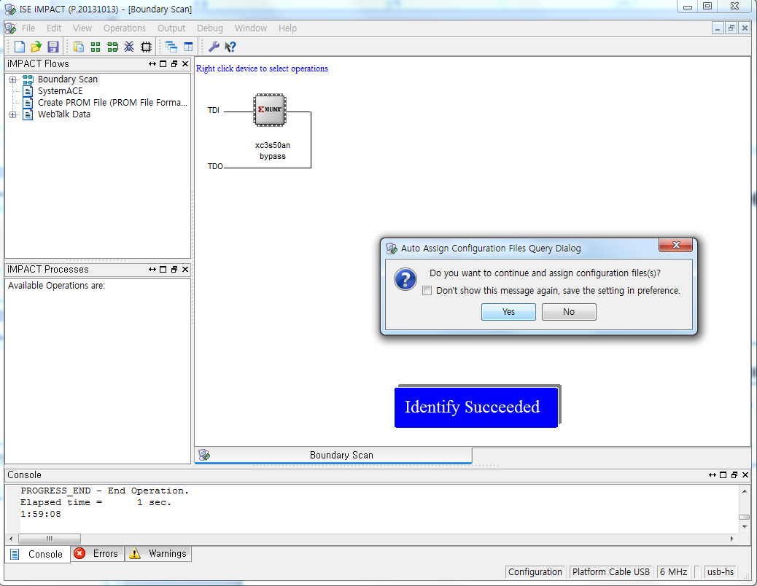
Half Adder on FPGA
Check the ‘Identify Succeeded’ notification, then click ‘Yes’ in the popup window to open your schematic source

Slide 35
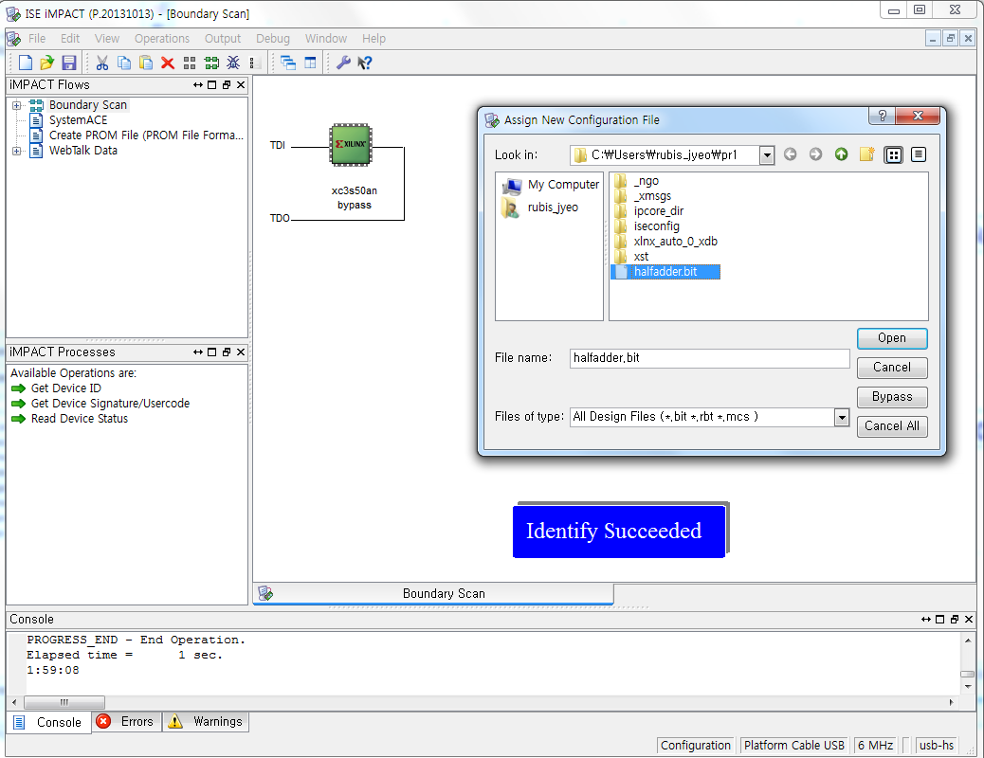
Half Adder on FPGA
Click and open the schematic source you’ve written

Slide 36
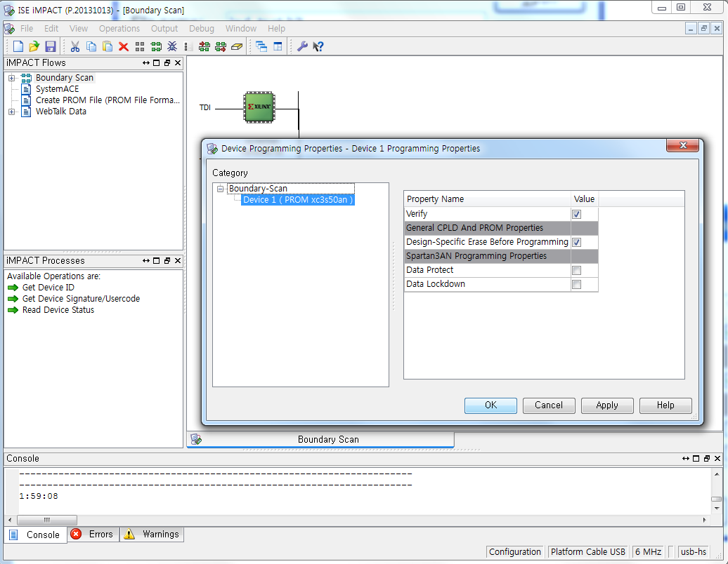
Half Adder on FPGA
Check the following settings and click ‘OK’

Slide 37
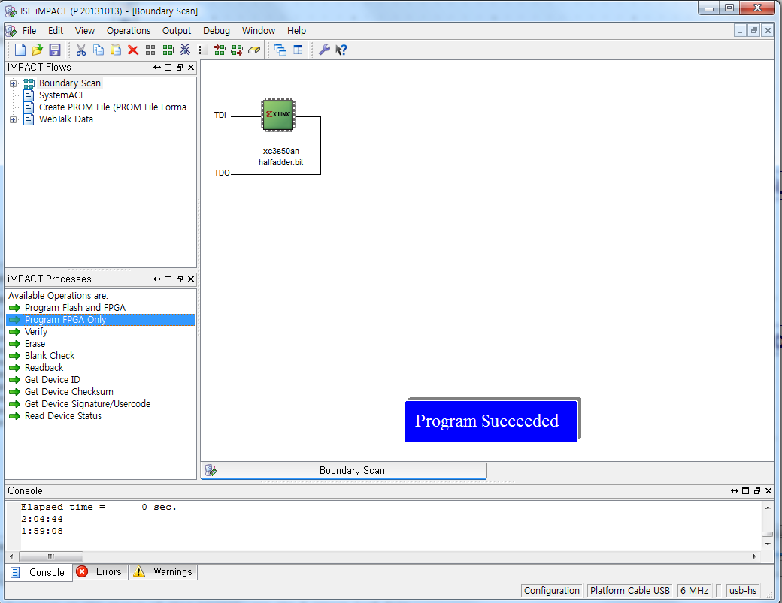
Half Adder on FPGA
Double click ‘Program FPGA Only’, then check the ‘Program Succeeded’ notification.

Slide 38
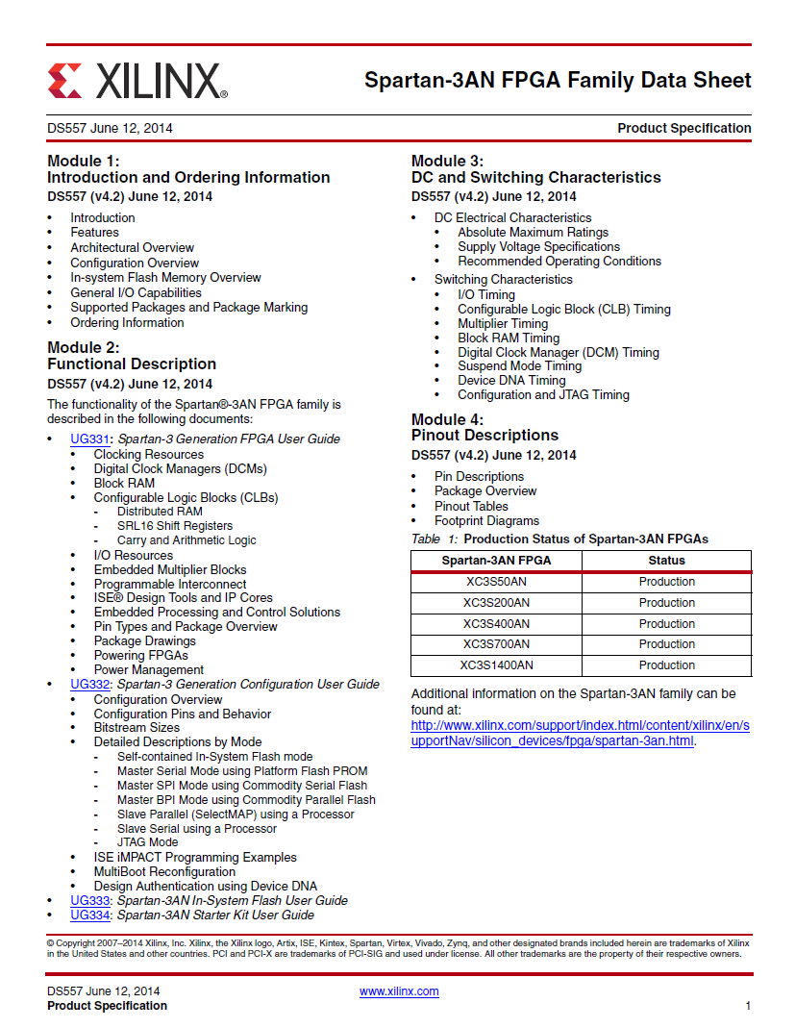
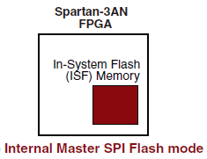
Using In-System Memory
FPGA are sprouted from PROM(Programmable Read-Only Memory) which is non-volatile
Nowadays, most FPGAs consist of SRAM(Static Random-Access Memory) which is volatile, to increase capacity
So, some non-volatile(hybrid) FPGAs (including our Spartan-3AN) has an internal flash memory
Using this ISF memory, your program will
not be erased after power turnoff

Slide 39
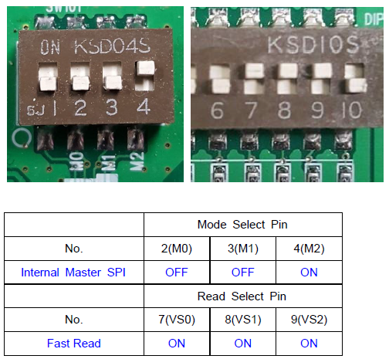
Using In-System Memory
To program ISF memory through JTAG, set Mode Select switches and dip-switch as below

Slide 40
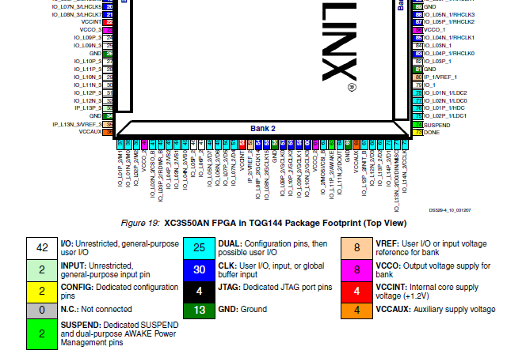
Using In-System Memory

Slide 41
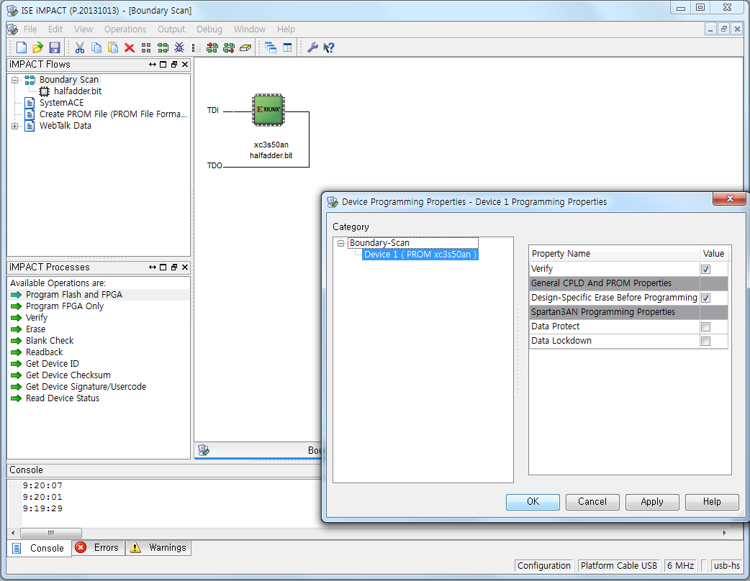
Using In-System Memory
Double click ‘Program Flash and FPGA’, check the settings and click ‘OK’

Slide 42
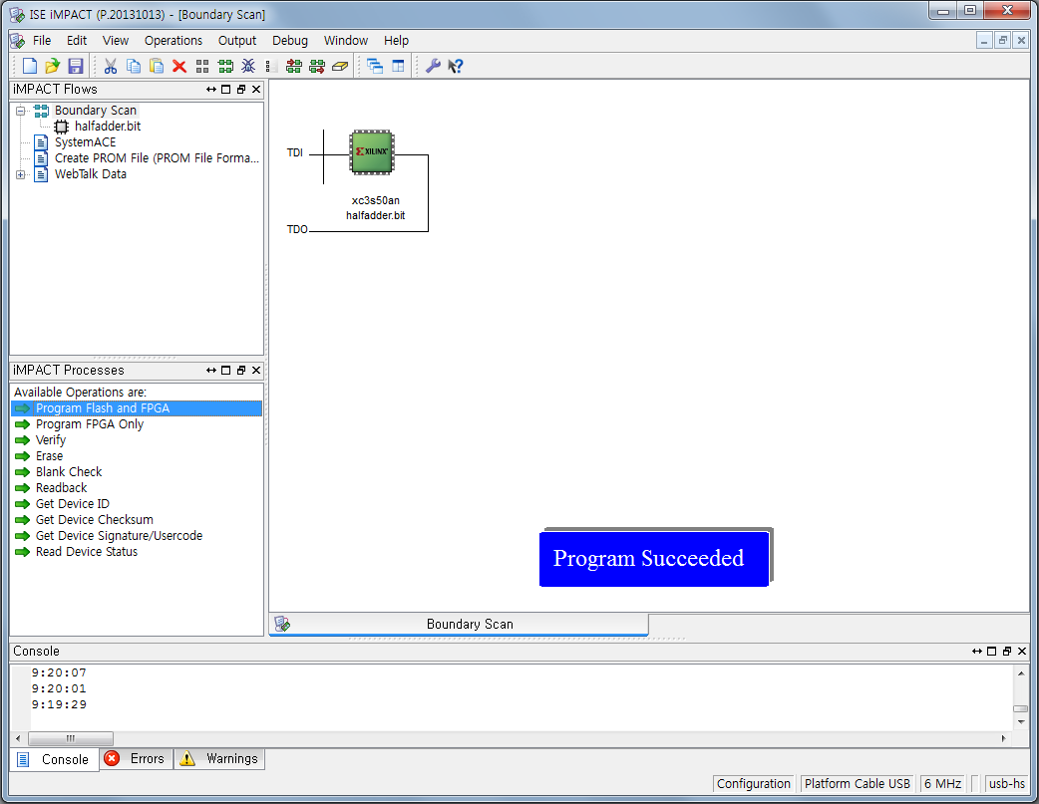
Using In-System Memory
Check ‘Program Succeeded’ notification

Slide 43
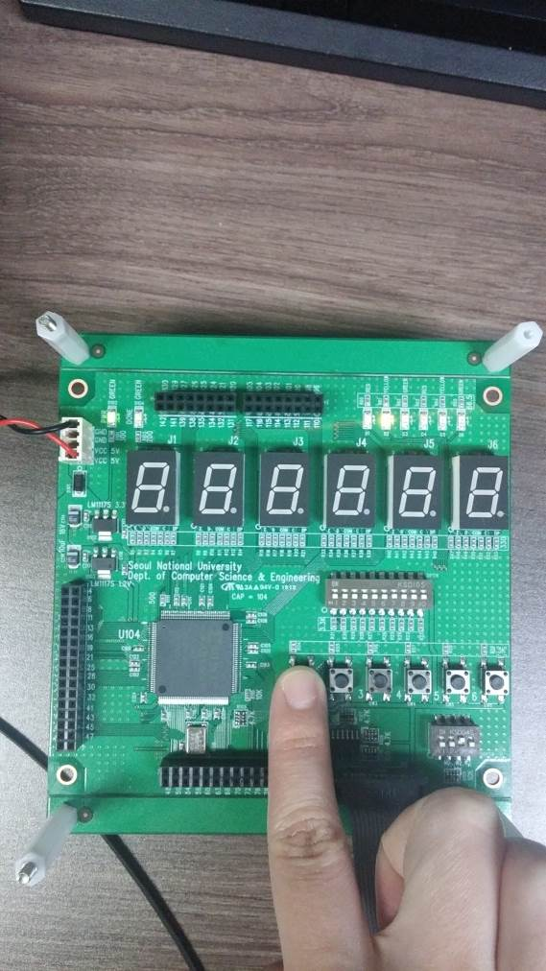
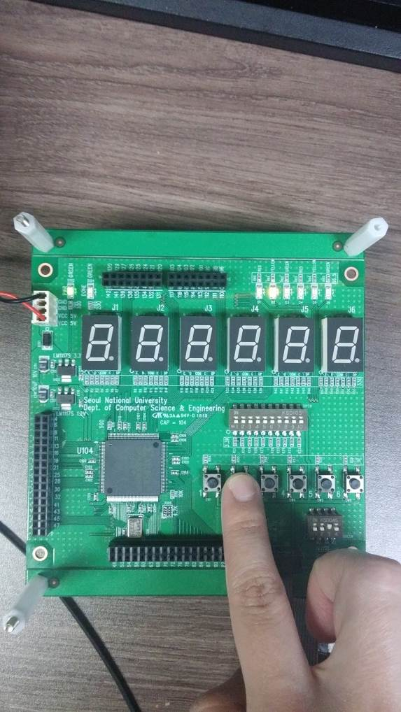
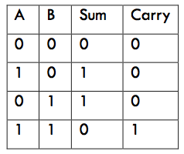
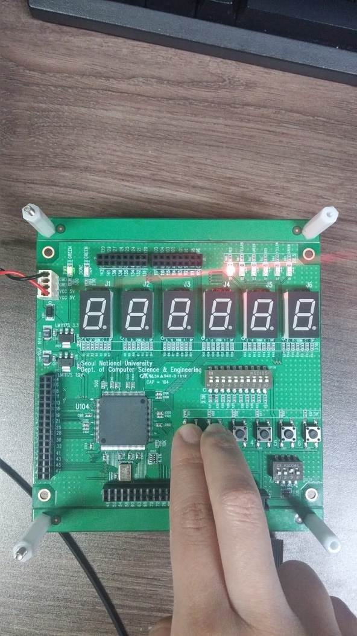
Half Adder on FPGA
Check the result on the board with your inputs and outputs

Slide 44
Lab

Slide 45
Lab
Implement and Simulate a 8bit Universal Shift Register in Verilog
Show all 4 modes of the module
Implement and Simulate a 4bit Binary Counter in Verilog
EN D C B A
LOAD
CLK
CLR
RCO
QD QC QB QA

Slide 46
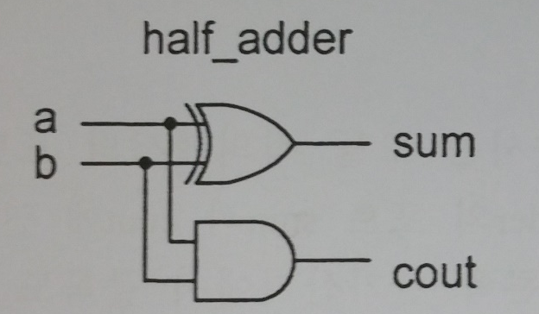
Lab
Design a 1-bit half adder and program it on the FPGA board
TA will check the function of half adder on FPGA with user-IO
Half Adder
Example →
Input: tactile sw
Output: LEDs

Slide 47
Homework
Implement and simulate a Pattern Recognizer
There are 1-bit input and 1-bit output in this pattern recognizer
This string recognizer detects ‘010’. If strings are inputted except ‘010’, the output must be ‘0’
Input ‘0100101001101011’ to verify your circuit at your simulating step

Slide 48
Homework
2. Implement a 4-bit Ring counter and Mobius (Johnson) counter and simulate it
You can implement external input ports for the initialization
OUT1
OUT2
OUT3
OUT4
IN
D
Q
D
Q
D
Q
D
Q
CLK
OUT1
OUT2
OUT3
OUT4
IN
D
Q
D
Q
D
Q
D
Q
CLK

Slide 49
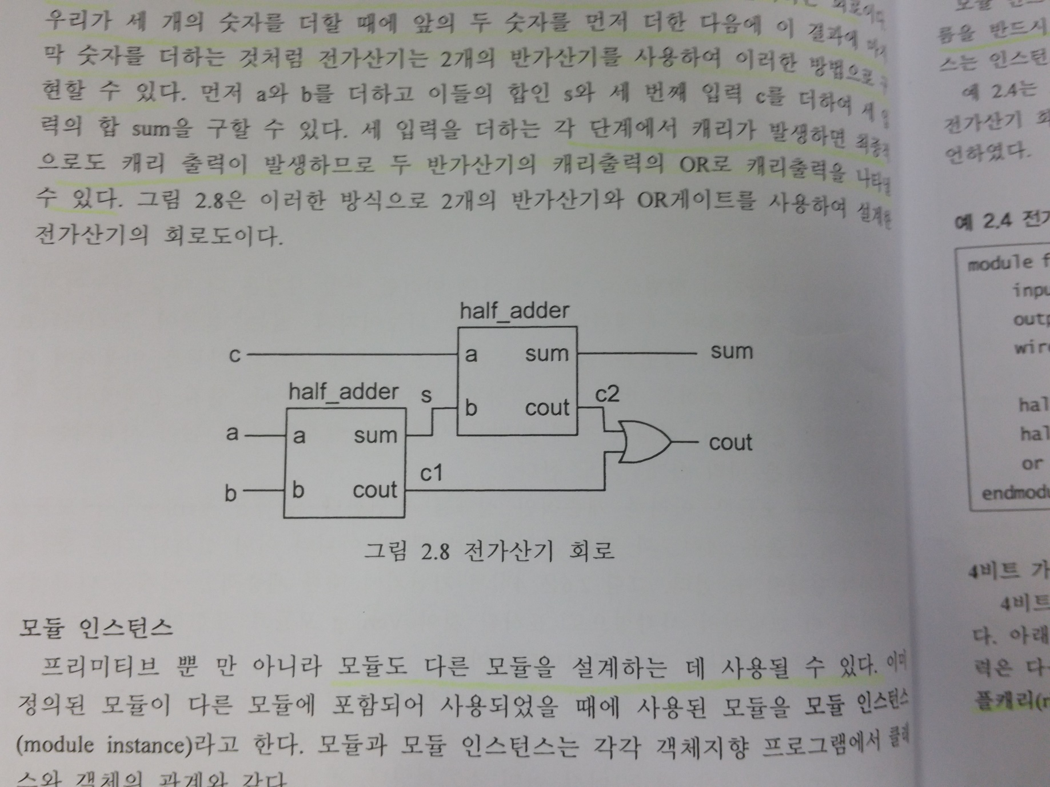
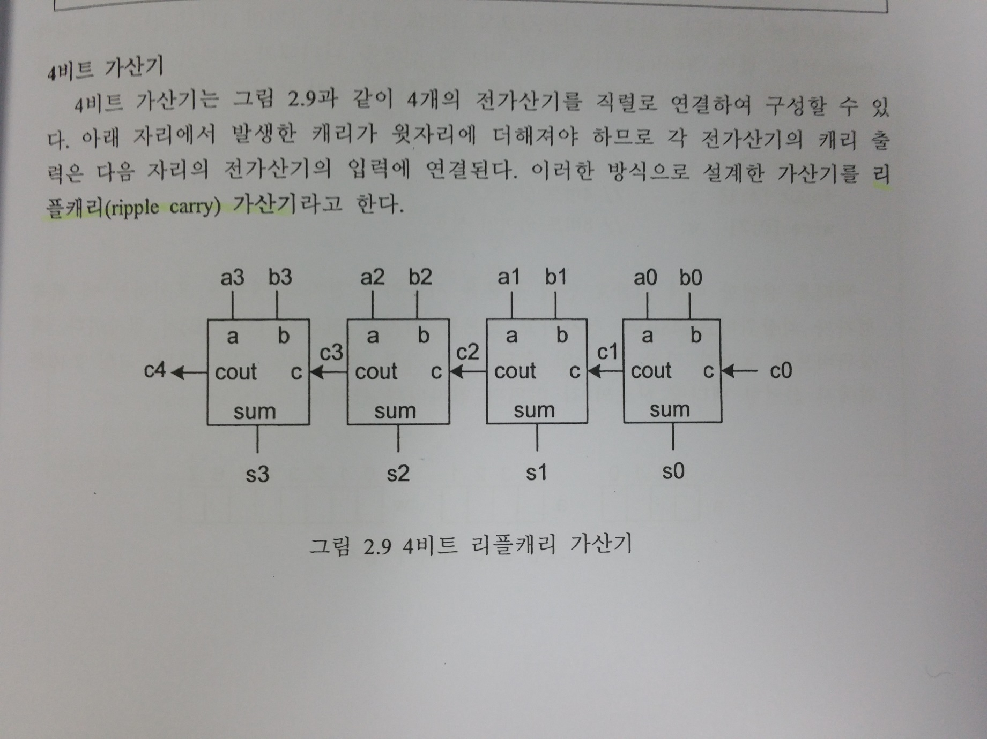
Homework
3. Design a 2-bit ripple carry adder shown below and program it on the FPGA board
(a) Half Adder
(b) Full Adder
(c) 2-bit Ripple Carry Adder

Slide 50
Report
Write a report
# of pages doesn’t matter
The file size should be less than 50MB
Due : 4 Nov. (Before class begin at 7:00pm)

